Slide 1
E-COMMERCE SALES INSIGHTS DASHBOARD
Power BI Dashboard Project
Presented by
Aiswarya OP

Slide 2
BUSINESS OBJECTIVES
Analyze the overall performance of E-Commerce sales data.
Identify sales trends and customer purchasing patterns.
Compare revenue and profit across product categories.
Evaluate payment methods and customer ratings.
Develop an interactive Power BI dashboard for data-driven decision-making.

Slide 3
DATASET OVERVIEW
Dataset Name : E-Commerce Sales Dataset
Source : Kaggle
Total Records : 50,001
Total Columns : 14
Data Type : Structured CSV Dataset
Key Attributes :
Order ID, Order Date, Product Category, Price, Discount, Quantity Sold, Customer Region, Payment Method, Rating, Total Revenue, Profit.

Slide 4
DATA UNDERSTANDING
Data Understanding
Before creating the dashboard, the dataset was analyzed to understand its structure.
The following were identified:
Numerical columns
Categorical columns
Date fields
Sales and customer-related attributes
This helped in selecting suitable visualizations for analysis.

Slide 5






METHODOLOGY
Dataset Collection
Data Cleaning
Data Transformation
Dashboard Development
Data Analysis
Business Insights

Slide 6
DATA CLEANING AND PREPARATION
Data Cleaning Process
The following steps were performed:
Removed duplicate records
Checked missing values
Corrected data types
Standardized data format
Created calculated measures
Prepared data using Power Query
Measures Created
Total Revenue
Total Profit
Total Orders
Average Rating
Average Discount %

Slide 7
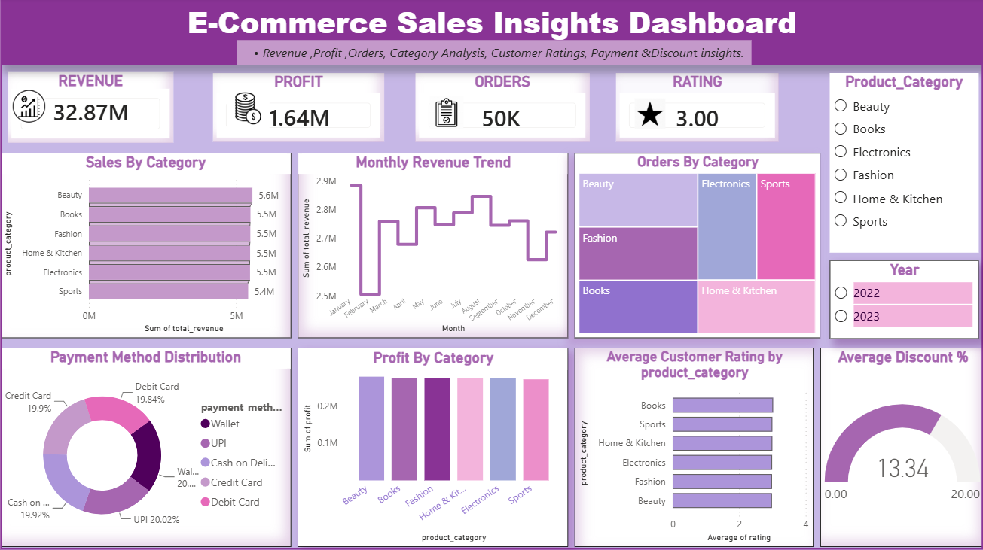
DASHBOARD SCREENSHORT

Slide 8
DASHBOARD COMPONENTS
KPI Cards
Revenue
Profit
Orders
Rating
Visualizations
Sales by Category – Horizontal Bar Chart
Monthly Revenue Trend – Line chart
Orders by Category – Treemap
Payment Method Distribution – Donut Chart
Profit by Category – Column Chart
Average Customer Rating – Bar Chart
Average Discount Gauge – Gauge Chart
Filters
Product Category
Year

Slide 9
INSIGHTS AND FINDINGS
Key Insights
Total Revenue: 32.87M
Total Profit: 1.64M
Total Orders: 50K
Average Customer Rating: 3.0
Average Discount: 13.34%
Beauty category generated the highest revenue .
Payment methods are almost evenly distributed .

Slide 10
CHALLENGES FACED
Challenges
Cleaning large dataset .
Handling missing values .
Creating DAX measures .
Selecting suitable visuals .
Dashboard alignment and formatting .
Maintaining a consistent dashboard theme .

Slide 11
LIMITATIONS AND FUTURE ENHANCEMENTS
Limitations
Dataset is static
No real-time data
Limited customer information
Future Enhancements
Connect live database
Add forecasting
Include AI insights
Add drill-through reports

Slide 12
TOOLS AND TECHNOLOGIES
Tools Used
Microsoft Power BI Desktop
Microsoft Excel
Power Query
DAX
Data Visualization Techniques

Slide 13
CONCLUSION
The E-Commerce Sales Insights Dashboard provides an interactive view of sales performance through meaningful visualizations.
It helps users to:
Monitor revenue and profit.
Analyze customer behavior.
Compare product categories.
Support data-driven business decisions.

Slide 14
THANK YOU

